Slide 1
Get Native with Just HTML5 and JavaScript
Keith Burnell

Slide 2

Little about me
Notes:
Like you – I am just a guy who loves his job and is passionate about further educating myself – learning the latest and greatest.
I am from the US, Green Bay Wisconsin specifically
Working for a Microsoft Consu

Slide 3
The plan for our time together
Why you need to have a mobile presence
The choice is yours
Kendo UI Mobile
Notes:
Mobile is absolutely something every non-desktop based developer needs to have in the forefront of their mind when developing.
As with everything in life you have a choice. We’ll look at the choices you have and weigh your options.
And then we will look at my technology of choice of when doing mobile Kendo UI
I want this to be beneficial for everyone, and I run a fairly loose ship – so if you have questions raise your hand and I’ll do my best to answer them with the group.

Slide 4

Notes:
Why?
Why should you care about making your site accessible to smart phones, tablets, phablets, etc.?
You may think that the effort required to make your site mobile friendly isn’t worth it…no ROI!

Slide 5

Notes:
To be “Captain Vague” for a minute….Mobile is huge!
But how huge? I know you guys are like me…even those of us with Macs…we are left brainers….we need evidence, something tangible and concrete.
Let’s look at the number…cuz they never lie!

Slide 6

6.8 Billion Cell Subscriptions
1.2 Billion Mobile Broadband Subscriptions
Mobile Broadband Growing 45% Annually
2x as Many Mobile-Broadband as Fixed
25% of U.S is Mobile-Only
30% of India is Mobile-Only
70% of Egypt is Mobile-Only
Notes:
There’s your numbers…if those numbers don’t convince you to act then you need to watch LOST!
No, seriously here are the numbers
- There are 6.8 billion active cellular subscriptions
- There are 1.2 billion mobile broadband subscriptions…so these are the folks with 3g and above
- Number of mobile broadband subscriptions growing 45% annually, so that 1.2 billion is growing rapidly
- Currently twice as many mobile-broadband as fixed-broadband, that means there are potentially 2x as many people accessing your site via mobile devices as the desktop.
- 25% of US is only accessing the internet via mobile broadband
- 30% of India is Mobile-Only
- 70% of Egypt is Mobile-Only

Slide 7
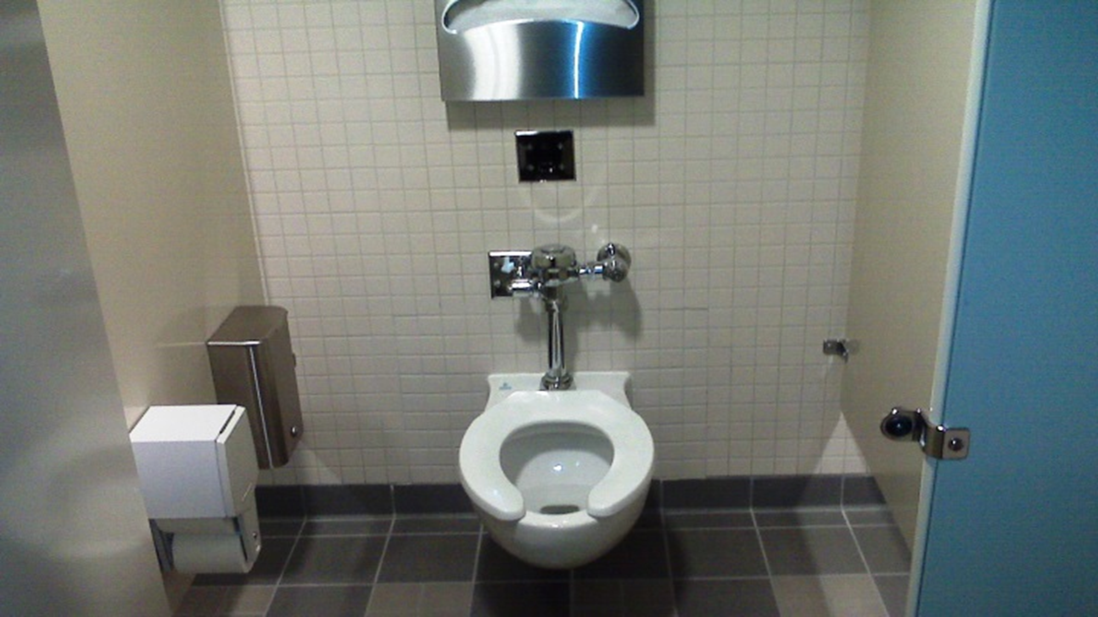
75% of People Use Their Phone on the Throne!

Slide 8
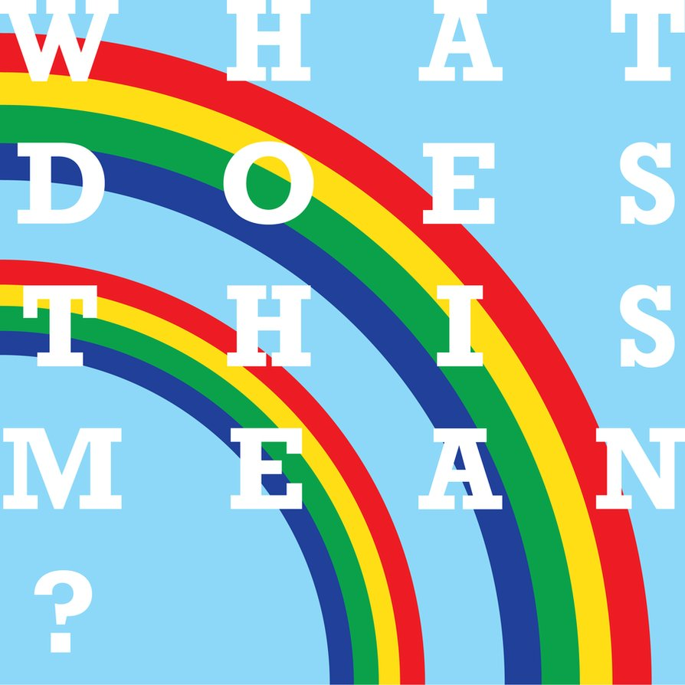
Notes:
If you don’t have mobile presence
Or you have a less than optimal mobile presence you are…
Missing Potentially millions of users and millions of dollars are being lost!

Slide 9

Notes:
So, I’ve convinced you with the numbers, your excited to go mobile, but now what?
Can I just jump in and start coding?

Slide 10

Notes:
Well, just like in the Matrix you have two choices.
On the one hand you have Native,
And on the other you have Non-Native or Hybrid.
And both choices have pros and cons so let’s look at the choices a little more closely so we can make an informed decision.

Slide 11





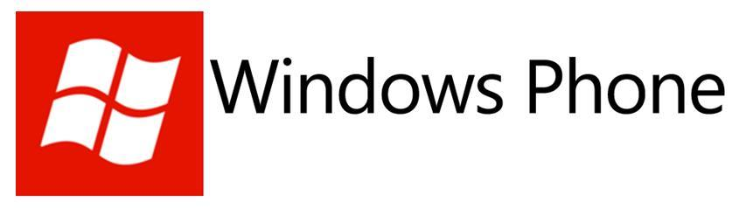


=
=
&
=
C#/XAML
=
Notes:
Your first choice is to go Native and create different applications for each device you want to target - - - in the devices native language.
Drawback
Multiple programming languages
Multiple IDE’s
Multiple API’s
All 3 of these things are drastically different between platforms.
Multiple code bases
Maintenance nightmare
Benefits
True mobile user experience in both the look and feel.
It runs on the metal so it will be faster
Access to everything on the phone the native API offers
Depending on the type of application you are writing these may be differentiating factors, but in my experience the majority of the time they are not.

Slide 12
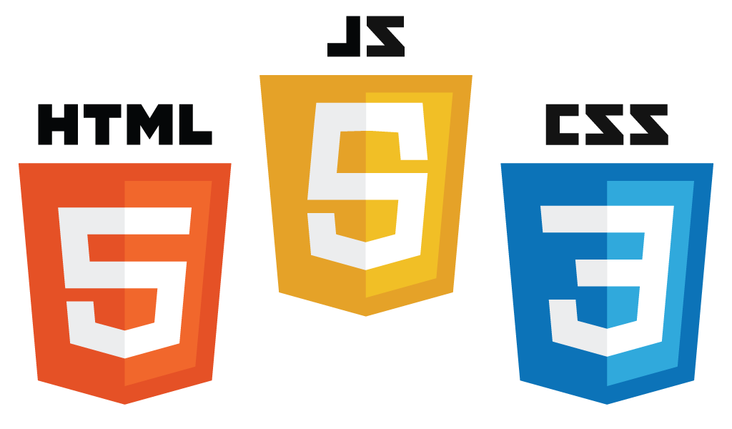
Notes:
And the other option is to create hybrid cross-platform applications using HTML5, JavaScript and CSS3.
Now these could either be apps only available via the web or what I would recommend is using a tool like Icenium or PhoneGap to package up your web project and put it in the major market places.
Benefits:
Reach everyone with a single code base
Single development environment
You are using web technologies that you are comfortable with and know well.
Drawbacks
Not truly native
Will run slower
Will not have access to everything you would have access to if you where using the native API’s.
And there is another major drawback, the look and feel
People come to expect apps running on their mobile devices to look and behave in a certain way…like the native apps that come installed on the device.

Slide 13
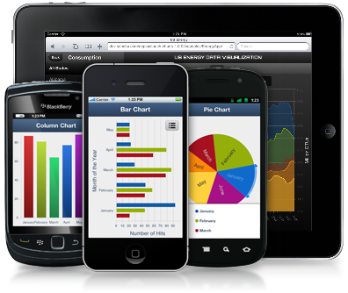
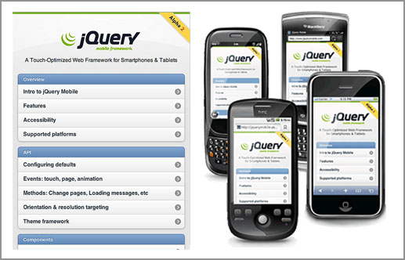
Notes:
But unfortunately just about every frameworks out there picked one mobile OS to mimic…and it was iOS.
So they have iOS styling with the header, navigation buttons, screen transitions, everything.
Trust me Android, BlackBerrry, and WP users don’t want apps on their devices that look and feel like iOS apps.
You can certainly do role your own device specific dynamic theming engine and I have done this, but it is painful and very difficult to maintain…and now that iOS 7 is out I have a client asking for it to be updated.

Slide 14
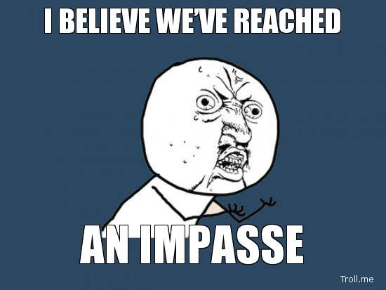
Notes:
So where does this leave us?
Are we doomed for a life of unanswered questions?
Yes. Yes we are. End of Presentation.
Just kidding.

Slide 15

Notes:
Luckily We are not doomed.
Enter Kendo UI and it’s Mobile toolset.

Slide 16
Code is available at: github.com/KBurnell/GetNative

